Slide 1
Predicting AirLine Delay using SPARKR

Slide 2
GOALS
The goal of this project is to :
Tell the airlines the parameters that influence the delay in flights.
2. Predict the airline delays
3. Classify the delays based on the external conditions such as time , weather.
DATA : 1. You can download the dataset from here : https://raw.githubusercontent.com/hortonworks/datatutorials/master/tutorials/hdp/predicting-airline-delays-usingsparkr/assets/airline_data.zipGOALS : The goal of this project is to : 1. Tell the airlines the parameters that influence the delay in flights. 2. Predict the airline delays 3. Classify the delays based on the external conditions such as time , weather. DATA : 1. You can download the dataset from here : https://raw.githubusercontent.com/hortonworks/datatutorials/master/tutorials/hdp/predicting-airline-delays-usingsparkr/assets/airline_data.zip

Slide 3
About DataSet
1. Day of Week 2. Carrier 3. Destination 4. Origin 5. Departure Hour

Slide 4
PROCESS OUTLINE
1. Data Ingestion from the above link.
2. Upload the data to HDFS
3. Create a SparkContext object that connects the program to cluster.
4. Exploratory Data Analysis in R
5. Feature Engineering on the dataset
6. Feature Selection on the dataset
7. Creating the testing and training datasets. 8. Use supervised methods to perform predictive analysis.
9. Use supervised methods to classify the delay based on weather.

Slide 5
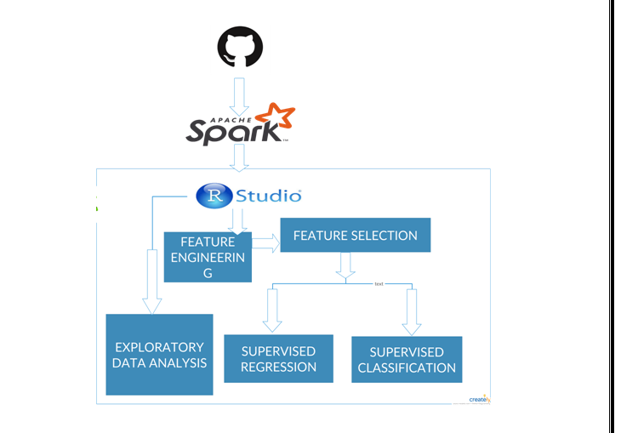
FLOW DIAGRAM

Slide 6
Machine Learning Components
Spark
Clusters
Classification models like Random Forest Classifier, SVM(Support Vector Machine), K-nearest Neighbor, Neural Networks.
Pipeline
Web App using Shiny

Slide 7
THANK YOU!!!!

